Slide 1

Lesson06
Wireframe

Slide 2
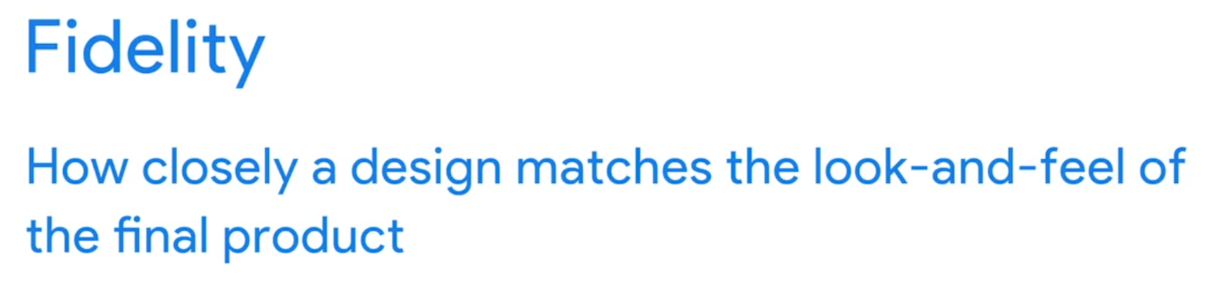
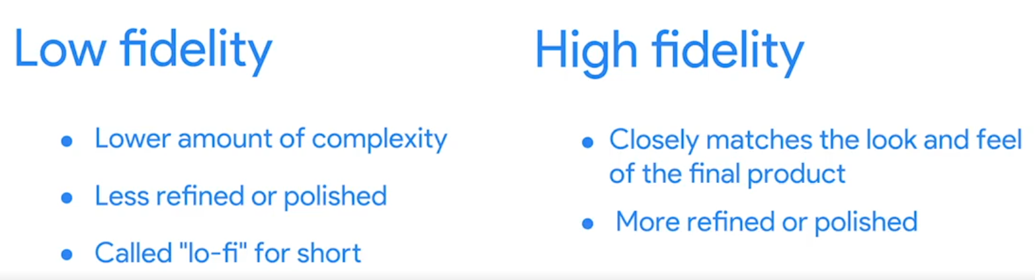
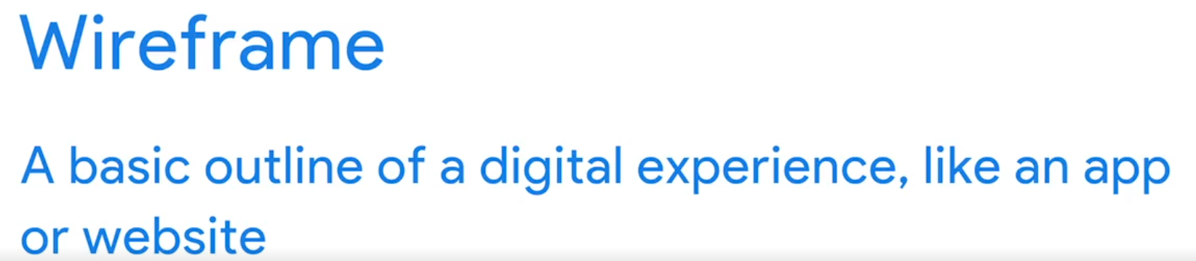
Introduction to wireframe
A wireframe is a basic outline of a digital experience, like an app or a website. As the name suggests, wireframes look like they were created with wires. They're mostly lines and shapes with some text. So why do UX designers create wireframes? Wireframes establish the basic structure of a page before any visual considerations, like color or images, are added.
Wireframes serve as an outline to get the team on the same page early in the project. Try using this as your guiding question when creating wireframes: How do I organize information on the page in a way that makes sense for users? Second, wireframes highlight the intended function of the product.
http://fpt.edu.vn

Slide 3
1. What is Wireframing?
Wireframing is a process where designers draw overviews of interactive products to establish the structure and flow of possible design solutions. These outlines reflect user and business needs. Paper or software-rendered wireframes help teams and stakeholders ideate toward optimal, user-focused prototypes and products.
http://fpt.edu.vn

Slide 4
What is Wireframing?
“Here is one of the few effective keys to the design problem — the ability of the designer to recognize as many of the constraints as possible — his willingness and enthusiasm for working within these constraints. Constraints of price, of size, of strength, of balance, of surface, of time and so forth.”
— Charles Eames, Pioneering designer, architect and filmmaker
http://fpt.edu.vn

Slide 5
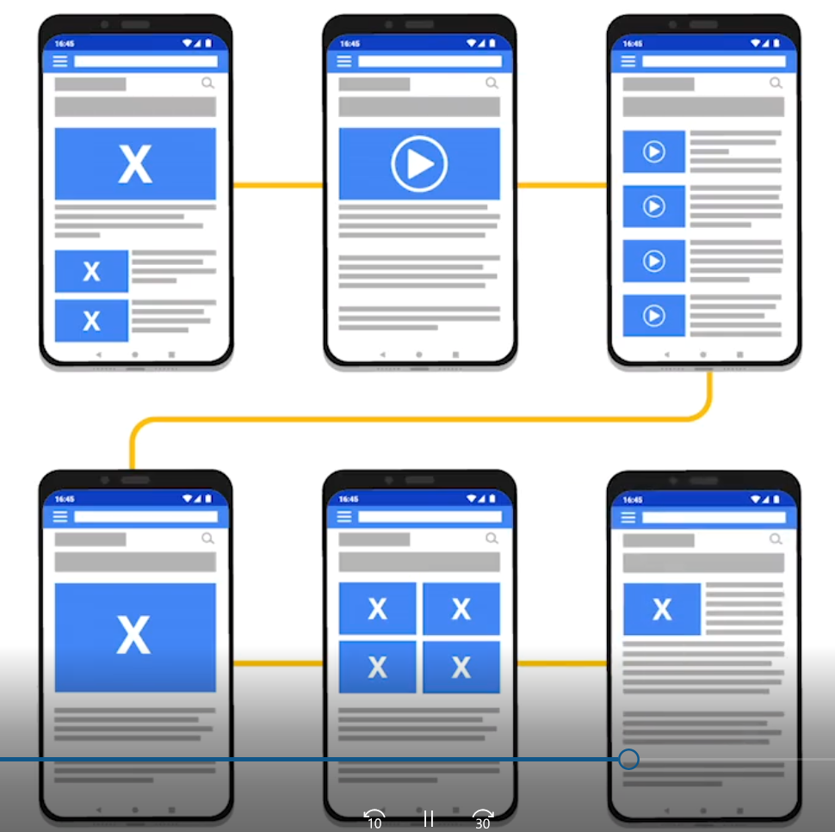
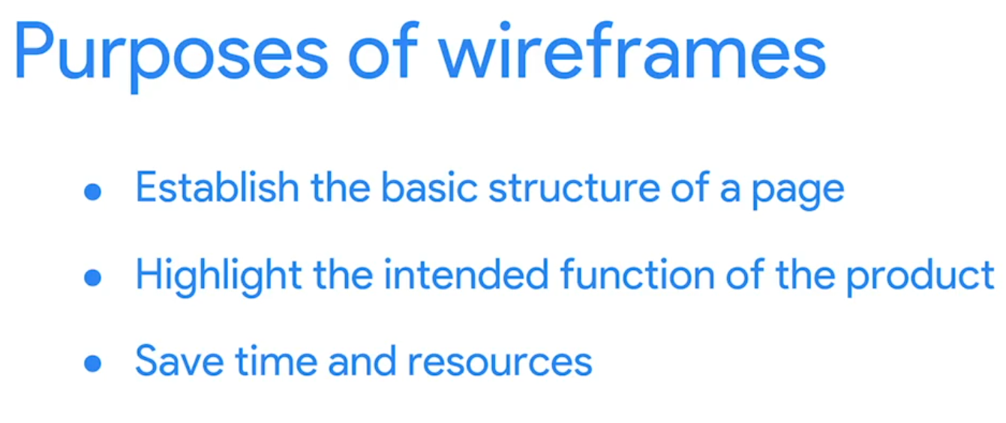
Creating Mobile App Wireframes
When drawing the wireframe, you should think about how the elements serve the overall functionality. For example, the function of a button should be clear, and that functionality is expressed through the way that it's drawn. We'll go through this in more detail later on.
Finally, wireframes help designers save time and resources. Wireframes allow the team to quickly try out different design options. They also serve as a guide for everyone involved in the project, which saves time later. You can create wireframes by hand or by using digital tools.
http://fpt.edu.vn

Slide 6
2. Creating Mobile App Wireframes
It's important to remember that product design is a multi-step process, and wireframing should not be the first step in this process. Before creating wireframes, it’s essential to invest enough time in user research. Qualitative and quantitative research data will act as a reference during wireframing.
http://fpt.edu.vn

Slide 7
Steps for wireframing a mobile app
Start by mapping out a target user flow
Sketch out the core part of the user flow
Start wireframing by setting a Mobile Frame
Determine layout using boxes
Use design patterns
Bring in actual copy
Ensure your content scales well
Connect the pages together to create a flow
Test your design decisions
http://fpt.edu.vn

Slide 8
Steps for wireframing a mobile app
Start by mapping out a target user flow
Sketch out the core part of the user flow
Start wireframing by setting a Mobile Frame
Determine layout using boxes
Use design patterns
Bring in actual copy
Ensure your content scales well
Connect the pages together to create a flow
Test your design decisions
http://fpt.edu.vn

Slide 9
Before creating wireframes
Map out a target user flow
Before starting wireframing, you need to have a clear idea of how many screens you’ll need to design and how users will interact with them. It’s much easier to get this understanding when you have a tangible user flow.
A user flow is a series of steps a user takes to achieve a specific goal. The user goal is a cornerstone element of user flow. To achieve a particular goal, a user might try a few different paths; that’s why user flows may not be linear.
http://fpt.edu.vn

Slide 10
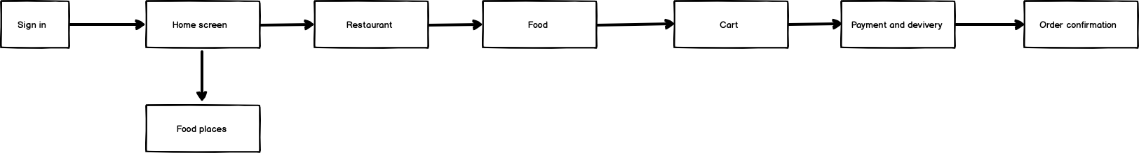
User flows will help you understand what wireframes you’ll need to create and how they should be connected.
It’s possible to visualize the flow using basic objects such as boxes and arrows. User flows can be created either on paper or in a digital tool. Below is a sample of a user flow for food delivery app created using Balsamiq:
http://fpt.edu.vn

Slide 11
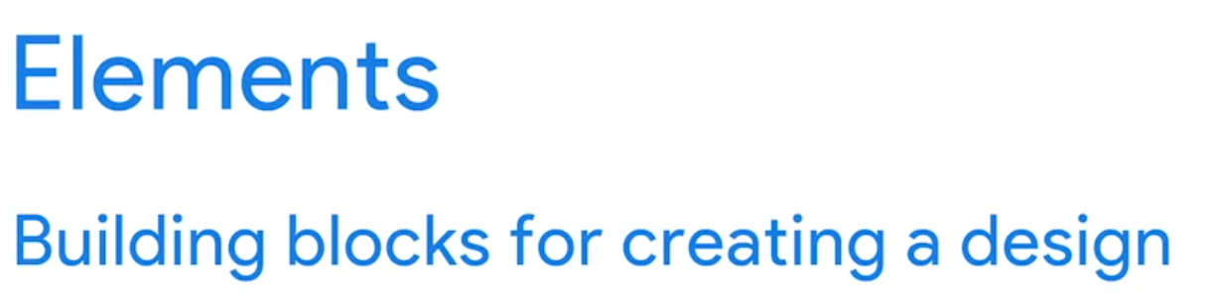
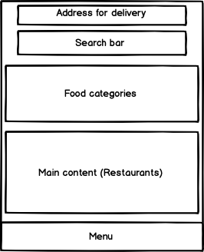
Sketch out the core part of the user flow: Elements
The goal at this step is to let your creativity shine and explore various design directions. In many cases sketching on paper or using a digital sketching tool works better for that.
Your wireframes will be made up of elements.
Elements are building blocks for creating a design
  Lines, shapes like squares and circles, and text.
http://fpt.edu.vn

Slide 12
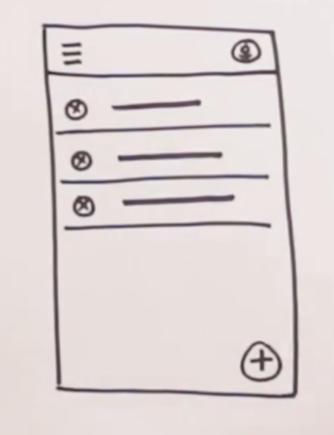
Sketch out the core part of the user flow: Elements
Add a top bar within the rectangle to simulate the app's header where information and actions related to the current screen are displayed. This bar typically extends nearly the full width of the top edge. Below this, place three dividers to organize content into sections, using thin lines for separation.
Detail these areas further: Begin with the top bar by inserting a navigation menu icon (three horizontal lines) on the left side, and an avatar (a large circle with a simplistic human icon) on the right side. In the segmented areas created by the dividers, draw circles on the left to represent images, marking each with an 'X' to denote their purpose.
Incorporate a functional element by adding a circle with a plus sign at the bottom right of the frame to simulate an action button. Adjacent to each image representation, draw horizontal lines to simulate text, ensuring these lines occupy only the middle portion of their respective sections to keep the layout clean and directed.
This wireframe resembles the Gmail app, serving as a practical example to help you understand the layout's functionality. Wireframe elements will vary depending on the app and the specific interface being designed.
Understand industry standards for wireframes, which dictate common representations: Text is shown as horizontal lines, images and icons as circles with 'X's, and actionable items like buttons are often rectangles or additional circles. These standards help maintain clarity and uniformity across designs.
http://fpt.edu.vn

Slide 13
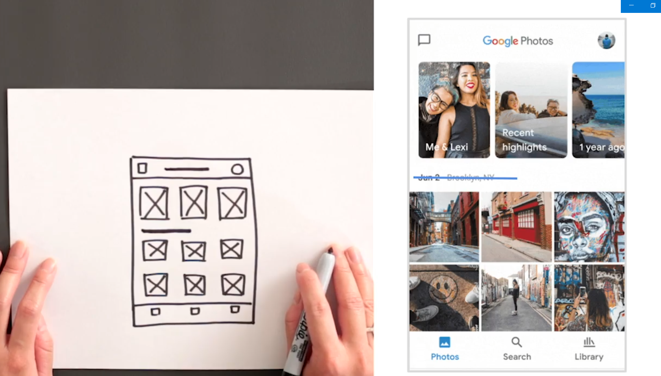
Draw your first wireframe
An easy way to practice wireframing is by recreating an existing app. In this exercise, we'll draw a wireframe of Google Photos. Start by drawing a large rectangle for the phone's frame. Next, add a top bar that spans the entire width at the top and three rectangles below it, each with an X inside, spaced evenly to represent images.
Then, draw a bottom navigation bar across the entire bottom length of the frame and place two rows of three squares each above this bar, indicating additional content areas. In the top bar, include a small rectangle on the left and a circle on the right for icons. In the bottom navigation bar, insert three small squares for further navigation options.
Add straight lines in several places to represent text: one in the middle of the top bar, another spanning from the left to the middle of the frame under the three image rectangles, and small lines under each square in the bottom bar.
This simple activity introduces you to the basics of wireframing, helping you visualize app layouts and understand the placement of elements like text and icons.
http://fpt.edu.vn

Slide 14
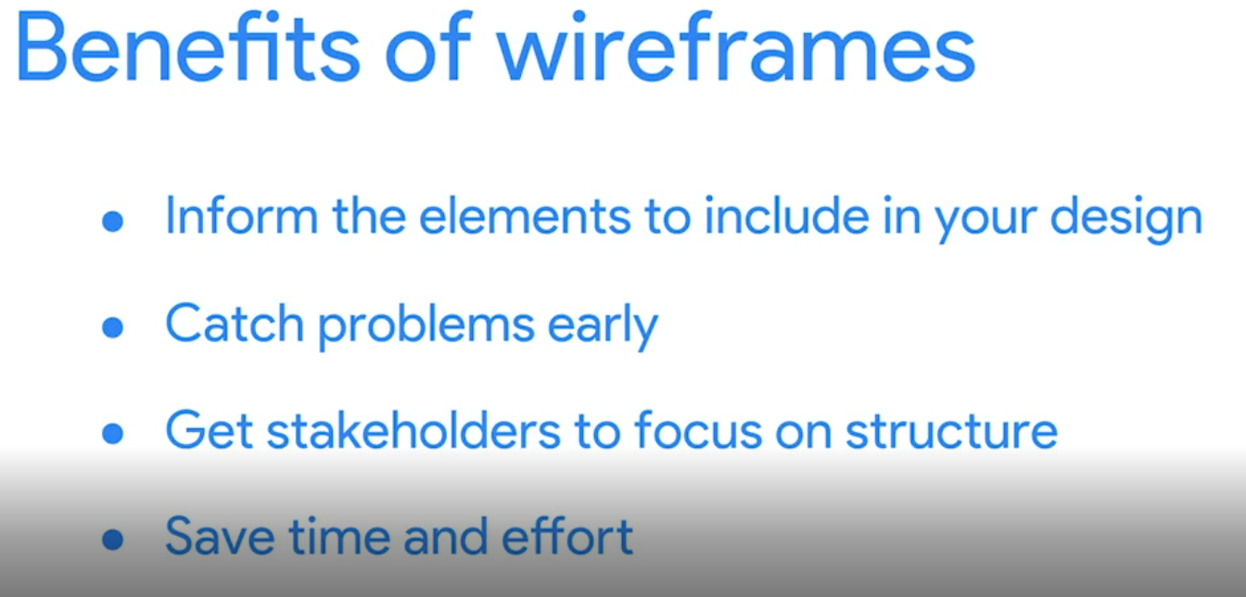
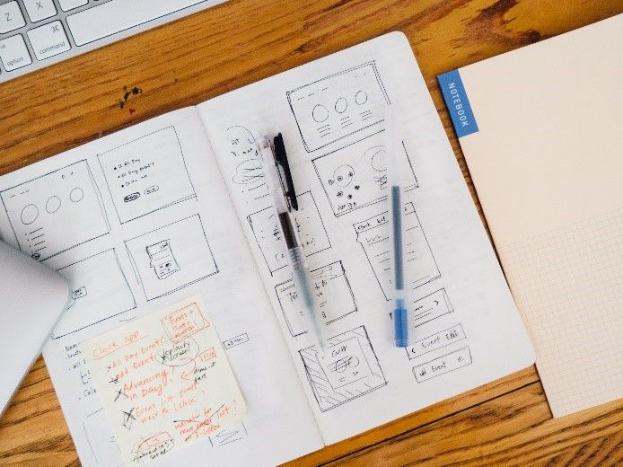
Benefits of wireframe
http://fpt.edu.vn

Slide 15
Information Architecture

Slide 16
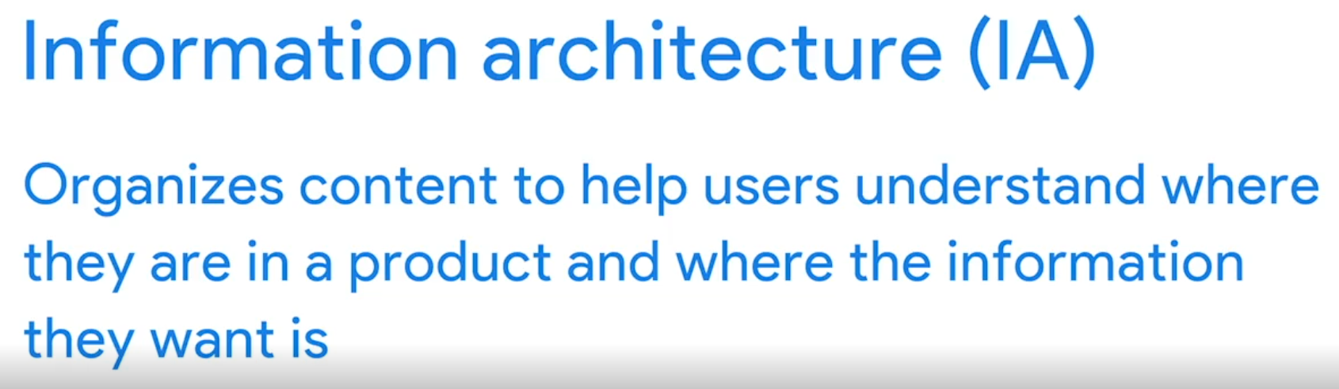
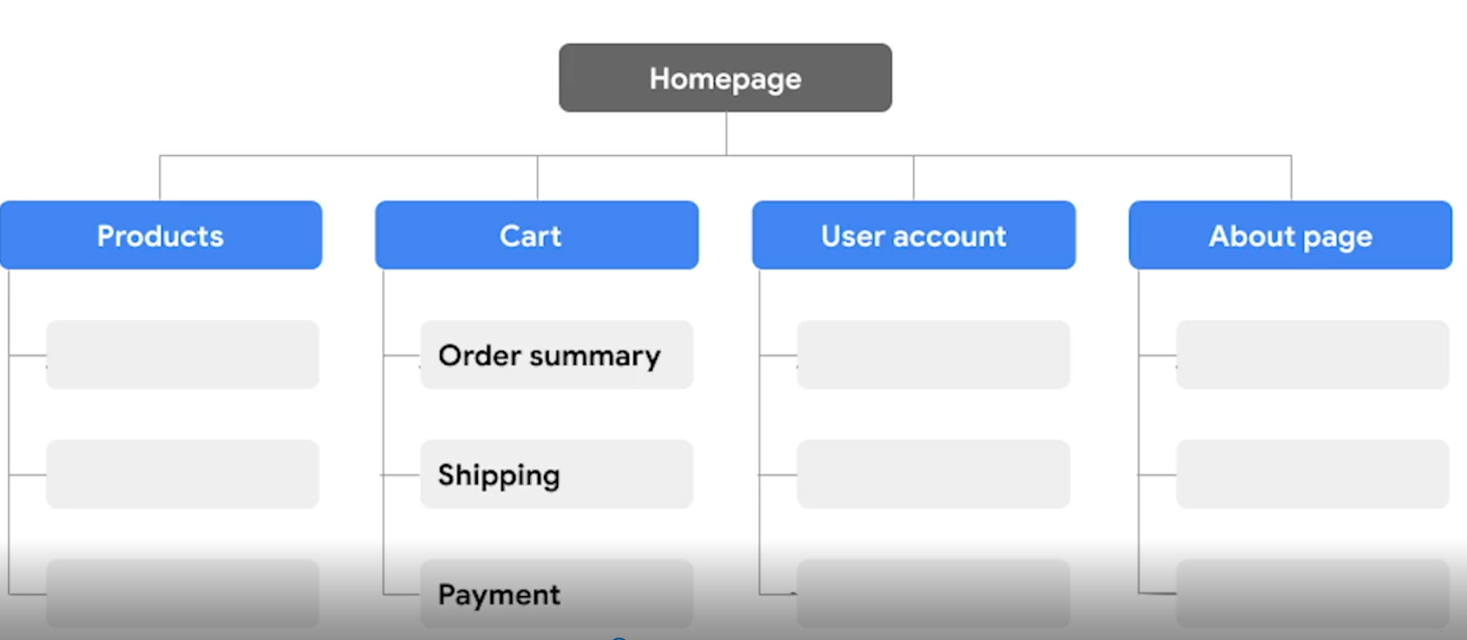
information architecture (IA)
information architecture (IA) which organizes content within a product to enhance user experience. IA acts as a navigational guide, helping users understand their location within the product and how to access the information they need efficiently.
We also discussed how IA is visually structured using lines and rectangles to represent different pages and sections of a site or app.
http://fpt.edu.vn

Slide 17
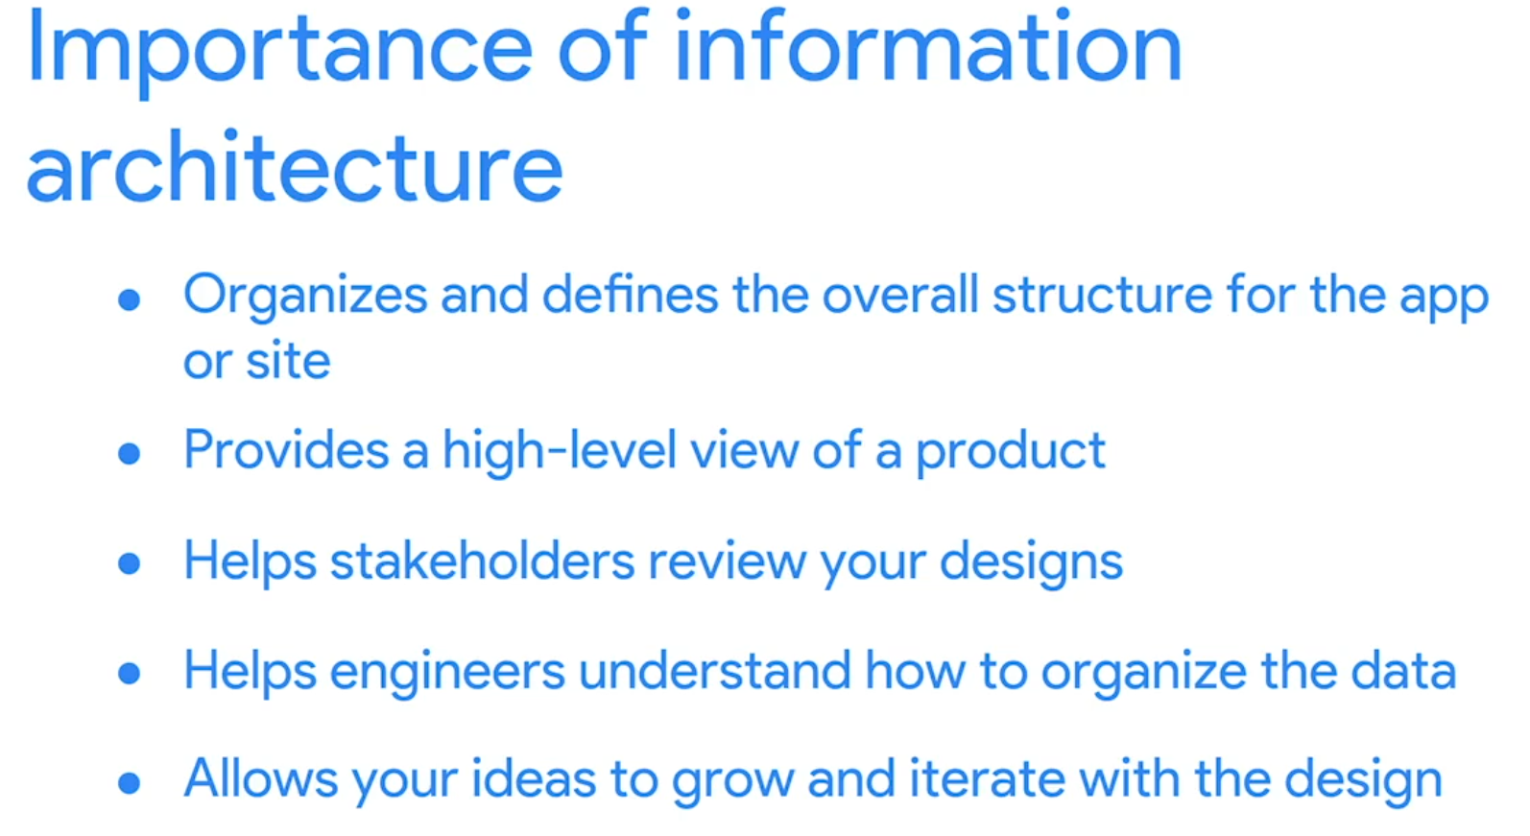
information architecture (IA)
Good IA not only benefits users but also simplifies the work for your colleagues. It should be flexible enough to accommodate changes and additional categories as your product evolves.
Once established, your IA will directly inform your wireframes, leading to clearer designs and a more thoughtful product. For example, a well-defined IA for a dog walking app will clarify how different app screens interconnect and guide user navigation, which is invaluable when you start drawing wireframes
http://fpt.edu.vn

Slide 18
Create WireFrame

Slide 19
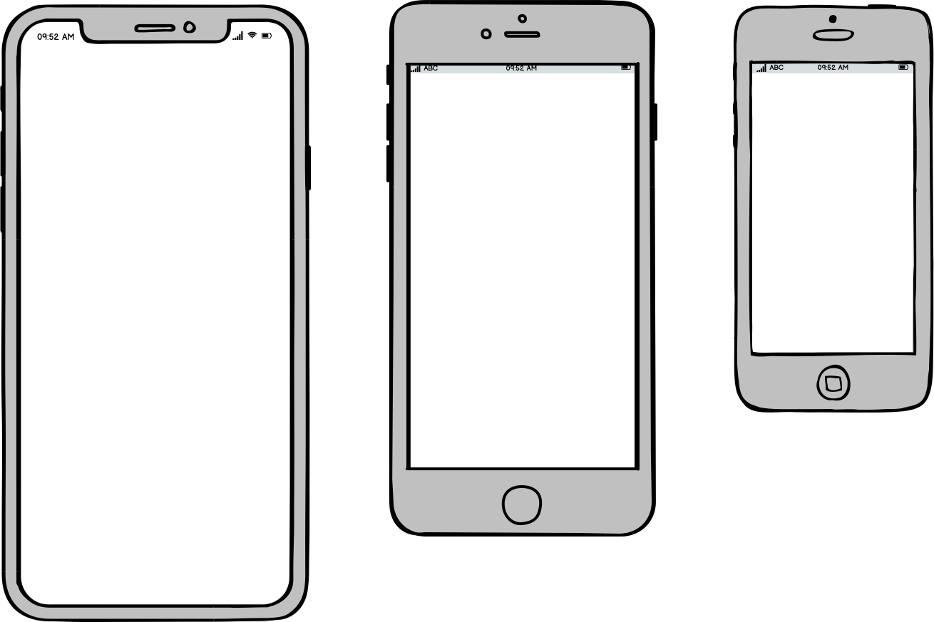

mid-fidelity wireframes
Set a mobile frame
While it’s possible to use a simple rectangle as a frame for your mobile design, it’s much better to select the frame that has dimensions of an actual device you design for. First, the frame will act as a natural constraint — it will prevent you from putting too many elements on the screen. Second, a frame will create an illusion of an actual design.
http://fpt.edu.vn

Slide 20
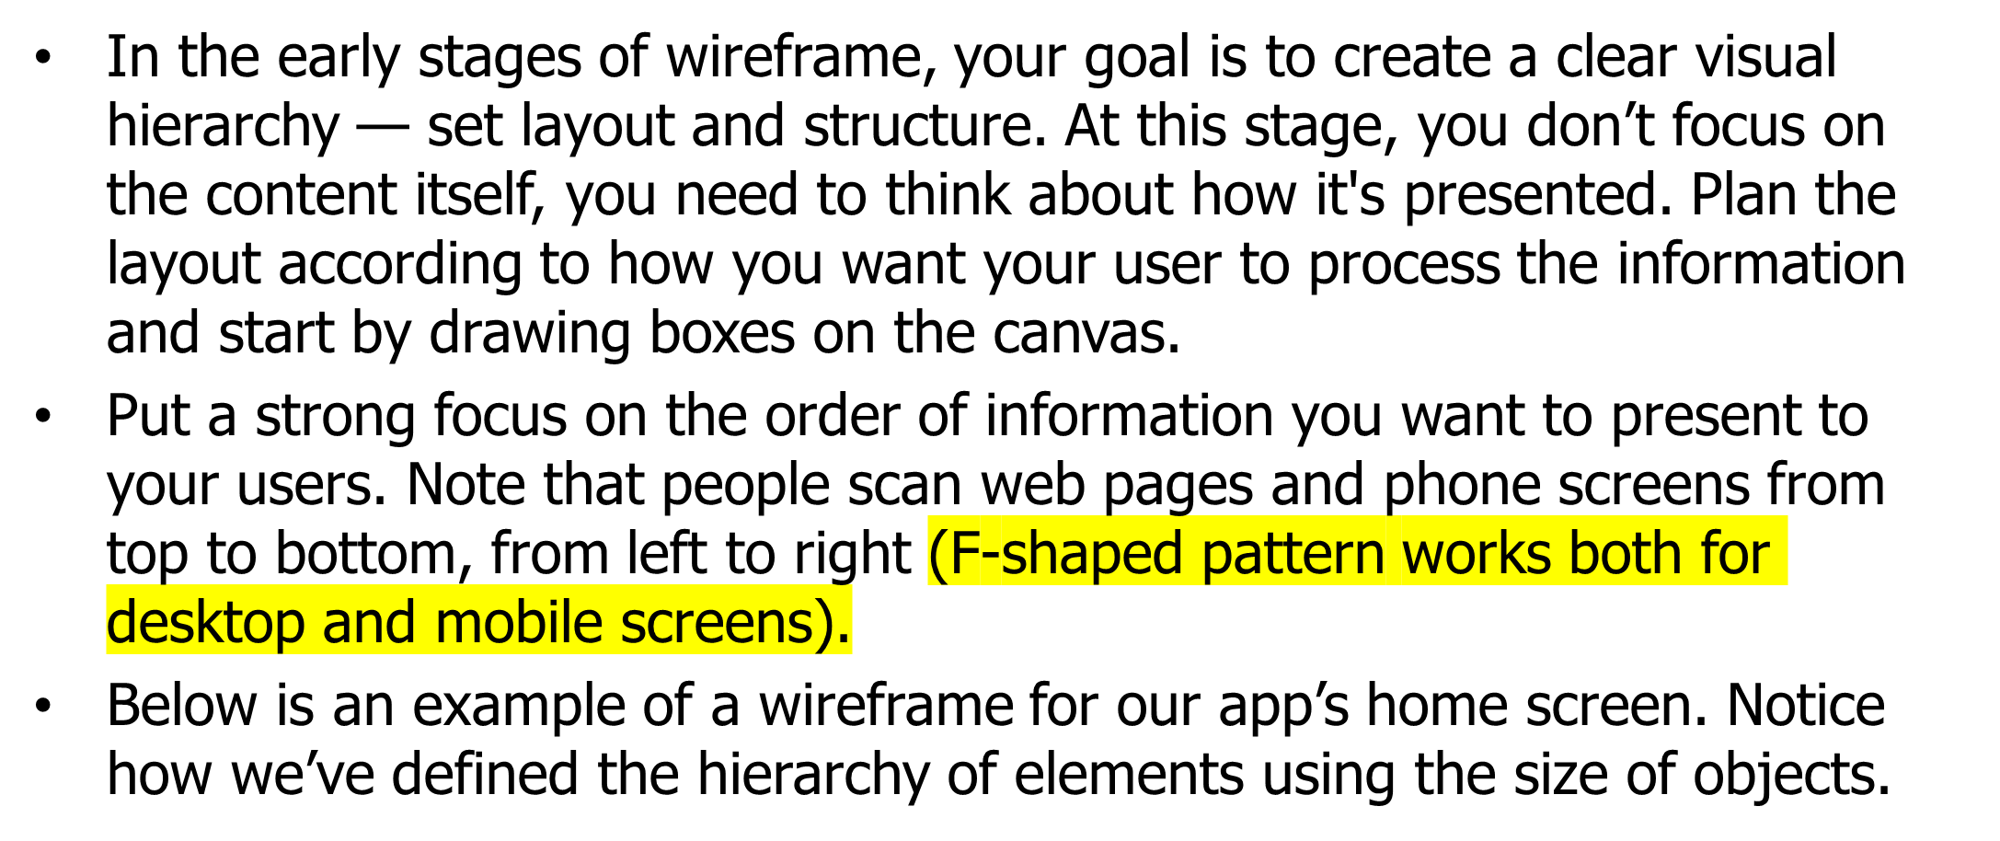
Determine layout with boxes
http://fpt.edu.vn

Slide 21
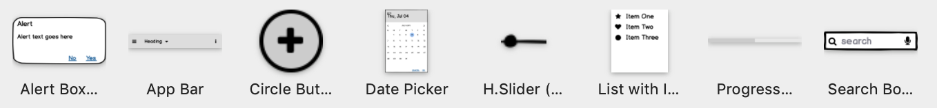
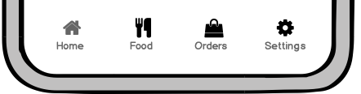
Use design patterns
Familiarity is one of the most important properties of good UX design. When people see familiar UI elements in a new product, they can rely on their previous experience when interacting with this product. Both Android and iOS have native design patterns that simplify the task of creating a familiar experience for designers. Design patterns act as reusable content blocks — it’s possible to use them to solve common problems (such as global navigation).
http://fpt.edu.vn

Slide 22
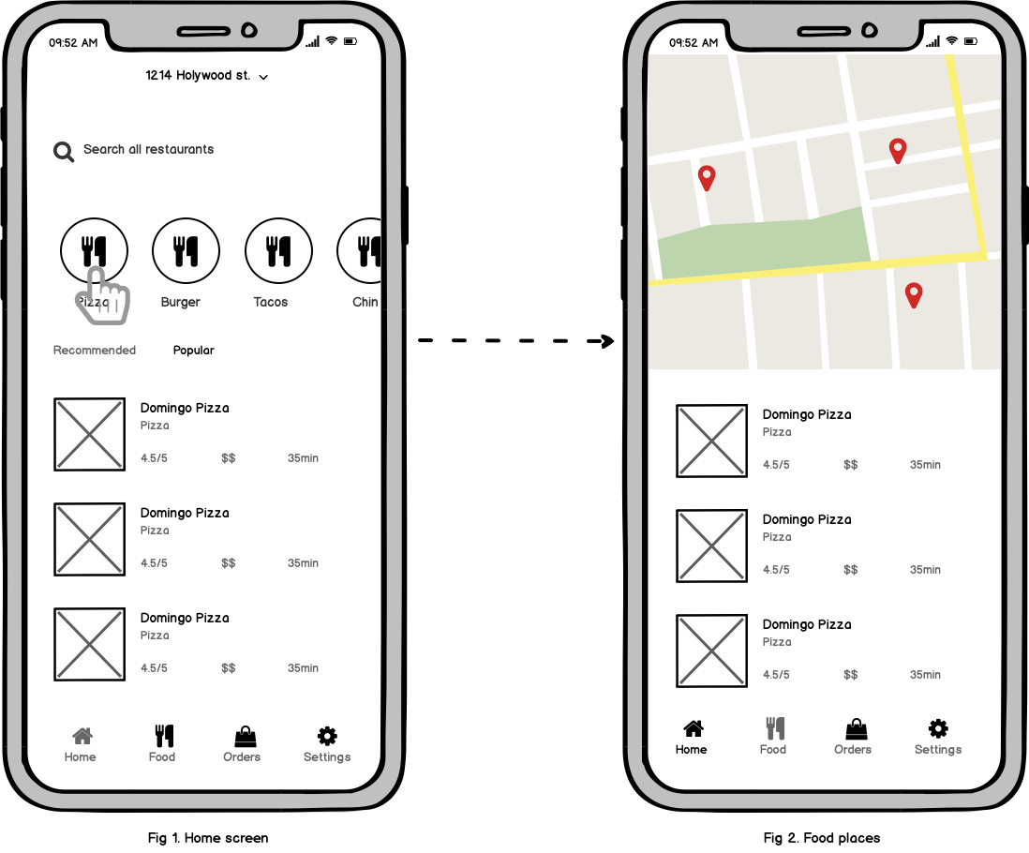
Connect the pages together to create a flow
While it’s possible to ship your design as a collection of individual screens, it’s better to create a flow out of them. UX flows make it easy for the team to understand the details of interaction scenarios — they communicate how people are supposed to interact with a product.
UX flows will also make you think about the app functionality as a whole. For example, after visualizing the UX flow, you might notice that you need to introduce an extra state between the home screen and a page with search results (because the backend of your system will take a few seconds to return the results).
http://fpt.edu.vn

Slide 23
Test your design decisions
Testing is the final (and one of the most important) steps in wireframing. Testing implies user interactions that's why this term is often used in the context of prototypes. But it’s possible to conduct simple testing for a flow created from wireframes. Using Balsamiq, it’s possible to create simple clickable prototypes by linking wireframes together. The goal of such testing is to see whether the screens work together.
http://fpt.edu.vn

Slide 24
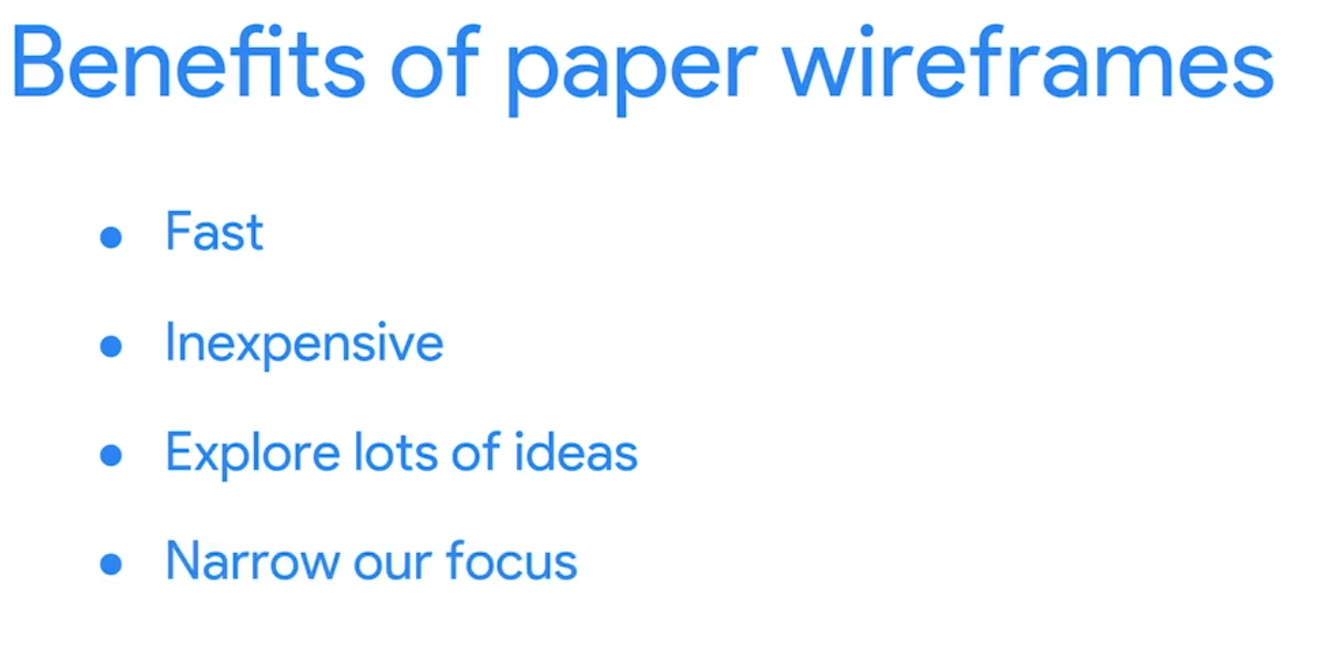
Create Paper WireFrame
Aim to create at least five different layouts to explore a range of ideas. After sketching, evaluate each version, highlight standout features, and decide which elements to carry forward into refined digital wireframes.
Ultimately, integrating the best aspects of your initial sketches into digital wireframes aids in developing a more coherent and user-friendly design. This iterative process is vital as it allows room for creativity and fine-tuning, ensuring the final product aligns closely with user needs and business goals.
http://fpt.edu.vn

Slide 25
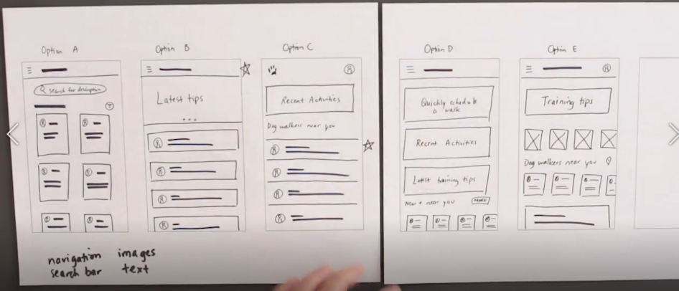
Create Paper WireFrame
http://fpt.edu.vn

Slide 26
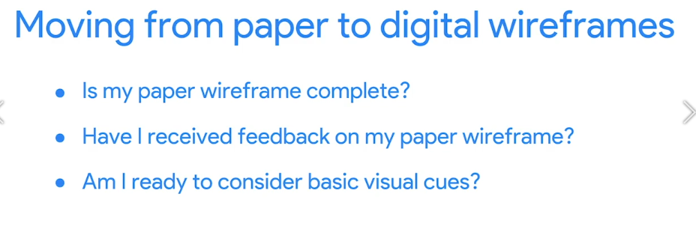
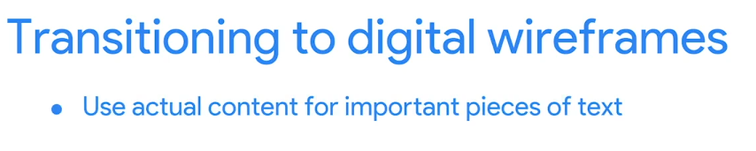
Transition from paper to digital wireframes
After exploring multiple ideas on paper and deciding which elements best enhance user experience, it's time to bring those wireframes to life digitally.
Digital wireframing introduces more complexity than paper wireframing, so ensure you are comfortable with your paper versions before moving on. To decide if you're ready for digital, ask yourself: Is my wireframe complete? Have I received feedback? Am I ready to integrate basic visual cues?
http://fpt.edu.vn

Slide 27
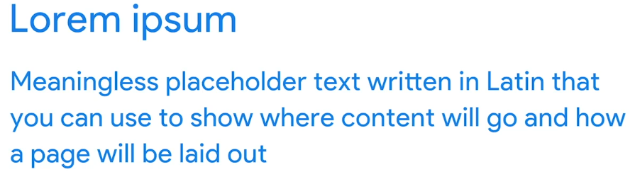
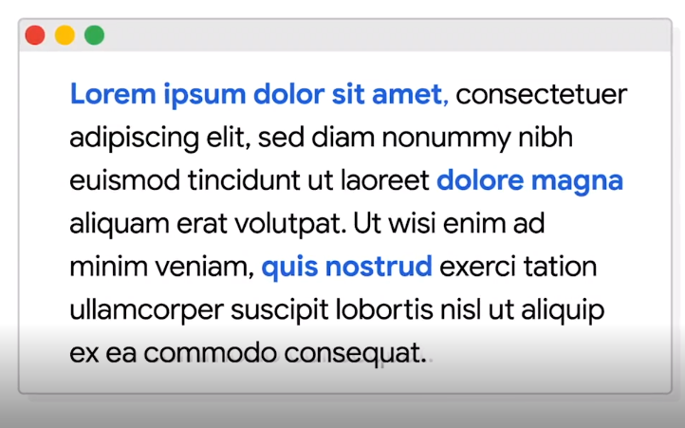
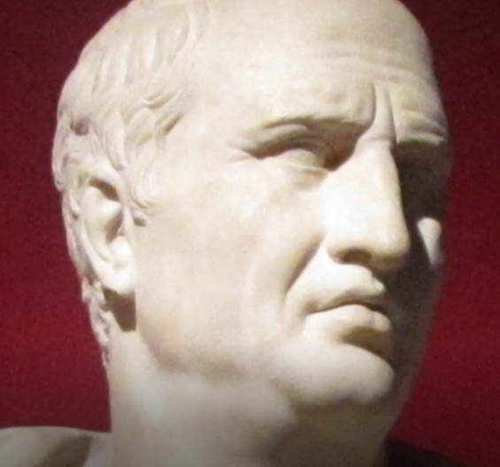
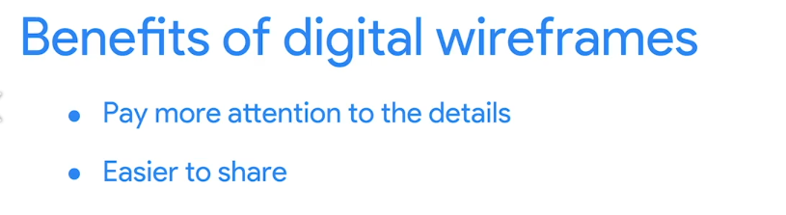
Transition from paper to digital wireframes
When transitioning to digital, it's essential to start incorporating actual content for important text elements, but save the expressive details like color and images for later stages.
Digital wireframes allow for greater detail focus and easier sharing with stakeholders. We'll soon explore transitioning to digital wireframes using tools like Figma.
http://fpt.edu.vn

Slide 28
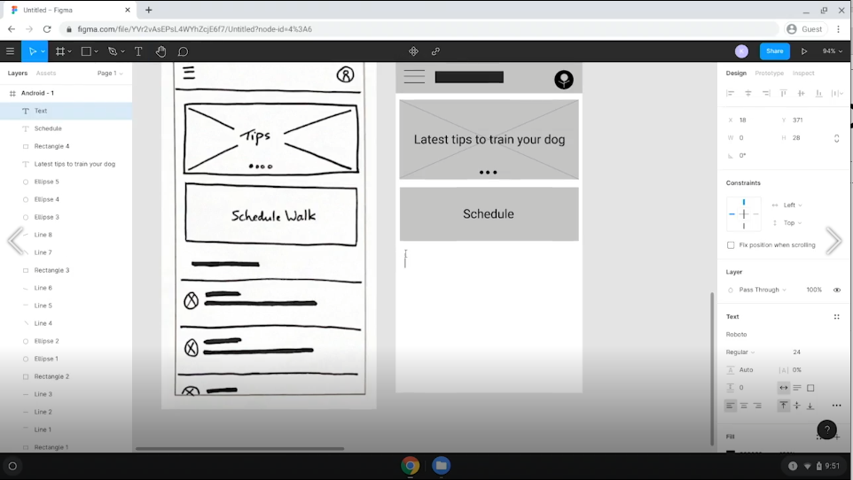
Create Digital Wireframe
http://fpt.edu.vn

Slide 29
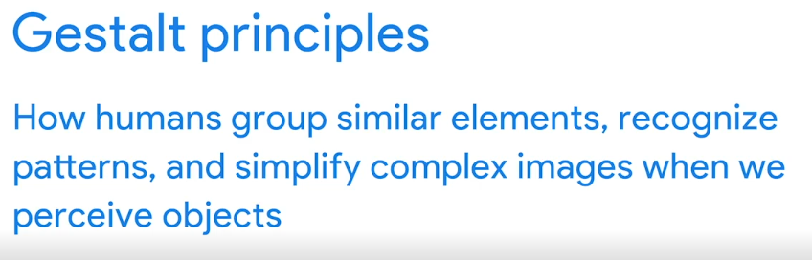
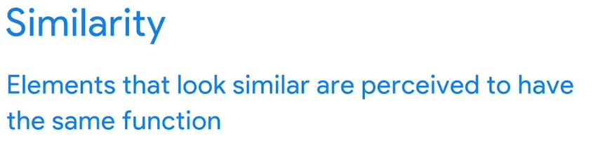
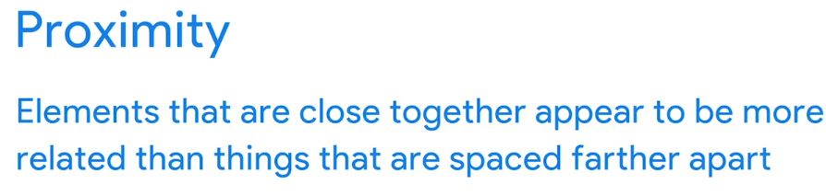
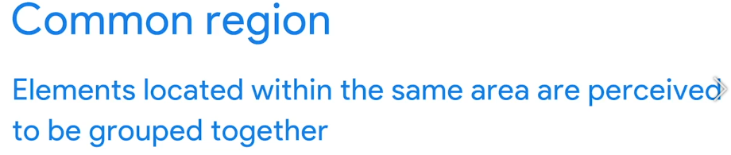
Use Gestalt Principles when creating wireframes
There are a few Gestalt principles that you can commonly apply to your wireframes, like similarity, proximity, and common region. Keep in mind, there are more Gestalt principles beyond these three.
Gestalt principles describe how humans group similar elements, recognize patterns, and simplify complex images when we perceive objects.
Basically, humans naturally notice the whole of something before noticing the parts. Gestalt principles got their name from the word Gestalt, which is a German word that means shape or form.
Have you ever looked at the clouds and tried to find shapes within them? You might have spotted a cloud that loosely resembled an animal or a familiar object. That's an example of Gestalt principles at work.
We unconsciously connect different elements in a scene to quickly understand them. In short, our brains are designed to make meaning at a glance.
http://fpt.edu.vn

Slide 30
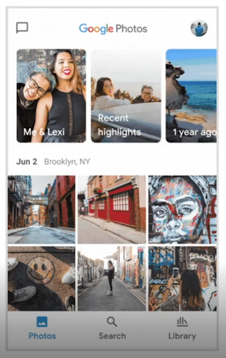
similarity
Let's examine one of the Gestalt principles, similarity. This principle means that elements that look similar are perceived to have the same function. Elements might look similar based on their shape, size, or color. One example of this is links within a webpage. They're almost always the same color: blue. This leads us to think that their function is similar too.
If you look closely, you'll notice that the bottom half of the app contains six squares that are the same size. Because they all have the same shape and size, you perceive these elements as being similar, or peers in a group. In this case, each square represents a photo and the function of each square is the same. If you tap on the square, it will enlarge to fill the full screen.
Here's the takeaway: When designing a wireframe, consider making elements that have a similar function look similar to give your app a more intuitive user experience.
http://fpt.edu.vn

Slide 31
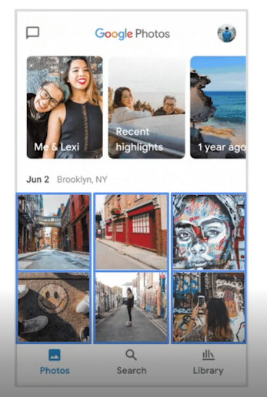
proximity
Now let's examine another Gestalt principle, proximity. This principle states that elements that are close together appear to be more related than things that are spaced farther apart. How does this play out in our Google Photos wireframe? At the top of the wireframe, there are three large rectangles placed close together in a row.
Because the rectangles are close together, our brains think they're related. It turns out our brain is correct. These three rectangles are photo albums, while the six squares below, which are placed more distantly from those rectangles, are just individual photos.
Here's the takeaway: When designing your wireframe, put elements that are related close together instead of far apart.
http://fpt.edu.vn

Slide 32
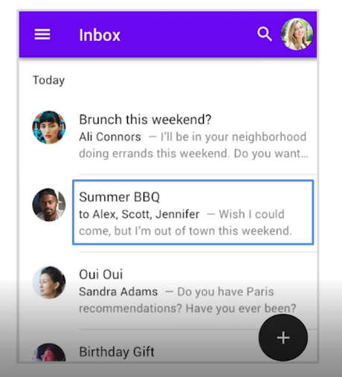
common region
This principle states that elements located within the same area are perceived to be grouped together. Let's think about this principle in our Gmail wireframe. The divider line creates a border around each email. The subject line, email recipients and email content appear to be grouped together.
Here's the takeaway: You can use borders in your wireframes to group elements together.
http://fpt.edu.vn

Slide 33
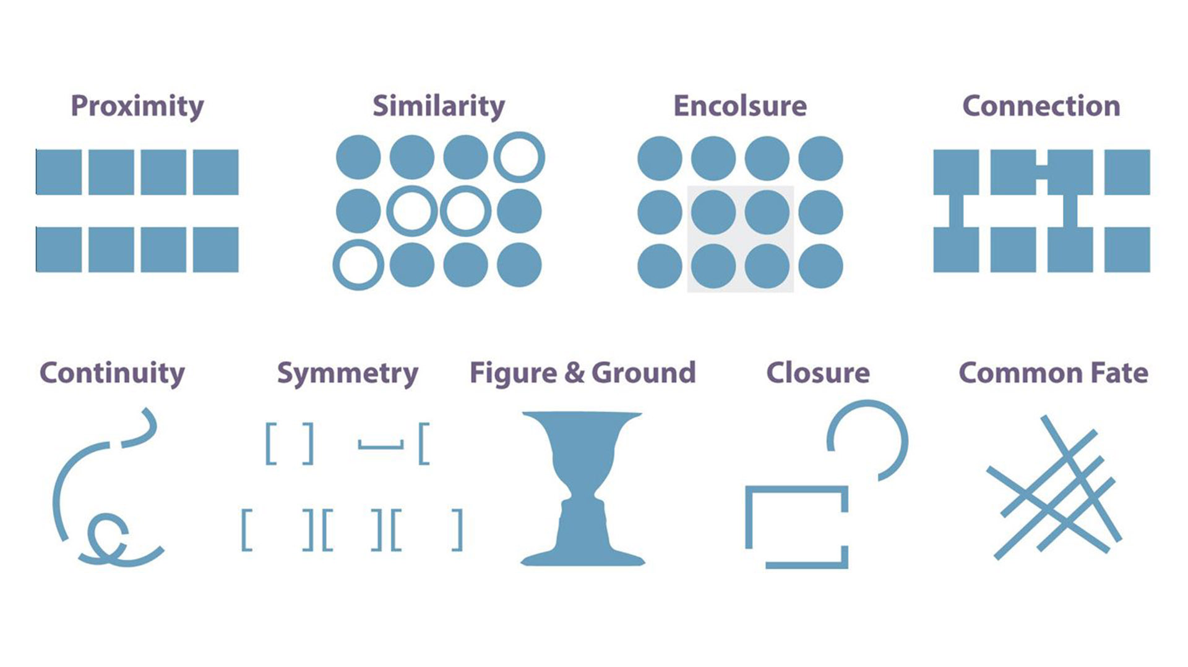
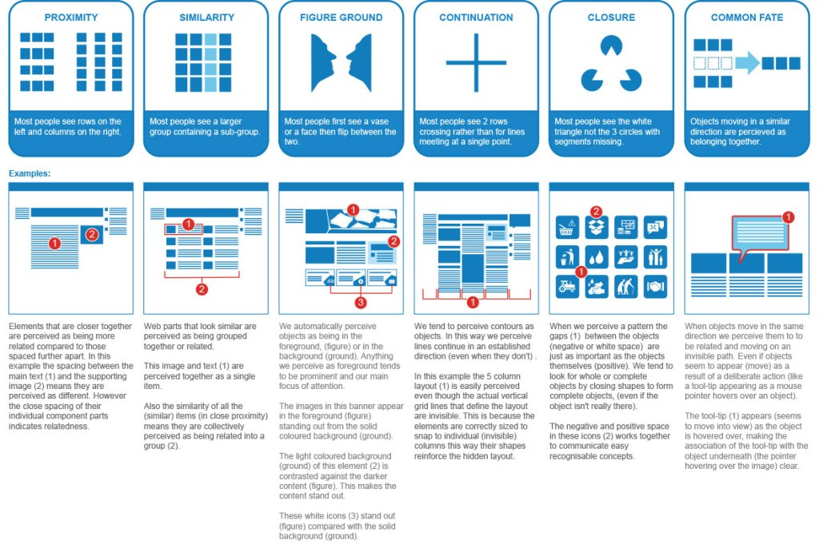
Gestalt Principles
http://fpt.edu.vn

Slide 34
Workshop
http://fpt.edu.vn

